Slide 1
CS 411 – Database Systems
Large Databases in the Real World: Tips and Tricks for Performance Tuning
Michael Wonderlich
Associate Director for Business Intelligence Architecture
Administrative Information Technology Services
mcwonder@uillinois.edu

Slide 2
AITS-Decision Support
Definition of Decision Support
Data warehousing, business intelligence, and information management
Mission
Support customers in colleges and departments
Support management, planning, and strategic decision-making
Supply information solutions and services
Accomplished by
Excellence in DW and BI practices
Integration: requirements, data, delivery

Slide 3
AITS-Decision Support
Services provided
Nightly ETL updates
DW/BI performance
Capacity planning
Technology upgrades
Security design
Data quality
Data education
Tool training
Metadata
Web site
Telephone support
Project support
Business Intelligence administration
Query Clearinghouse and Business Solutions
Report publishing
Data Visualization

Slide 4
AITS-Decision Support
Job Roles
Subject Area Expert
Business Analyst
Data Warehouse Designer
ETL Developer
Business Intelligence Specialist
Project Manager
Application Developer
Information Architect
Data Architect
BI Architect
Technical Analyst
Enterprise Architect

Slide 5
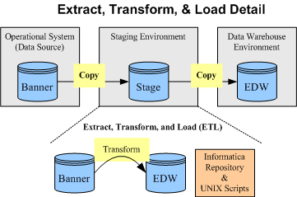
Loading the Data Warehouse

Slide 6
Center of the World - Data Warehouse (DW)
Size of Tables (in rows)
Rows % (rnd) # of Tbls
100M-175M 0.3 2
10M-99M 5 35
1-9M 18 136
500K-999K 9 66
100K-499K 11 86
10K-99K 15 115
1-9999 42 313
Total Tables: 753
# of Rows
2,115,617,779
Enterprise Data Warehouse (EDW) 677 tables
Data Mart(s) 76 tables
Code Tables 29% (218)
History Tables 21% (158, 29 are code tables)
# of Intermediate Tables
44
Truncate/Reload 60-65%
Incremental 35-40%
# of DW Source Tables
711
# of Rows
1,567,536,662

Slide 8
Business Intelligence
Business intelligence (BI) refers to skills, technologies, applications and practices used to help a business acquire a better understanding of its commercial context. Business intelligence may also refer to the collected information itself.
BI applications provide historical, current, and predictive views of business operations. Common functions of business intelligence applications are reporting, OLAP, analytics, data mining, business performance management, benchmarks, text mining, and predictive analytics.
Business intelligence often aims to support better business decision-making. Thus a BI system can be called a decision support system (DSS)

Slide 9
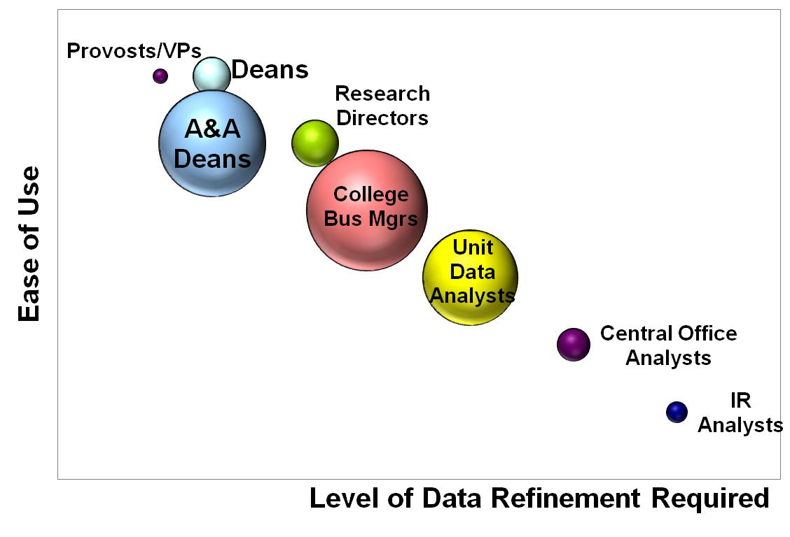
Information Delivery
High
Dashboards
Reports
Analytics
EDW Queries
Low
High
Level of Query Flexibility
Notes:
Delivering the right tool to right audience

Slide 10
Usage of the Data Warehouse
1,705 users from 456 different departments on 3 campuses
Approximately 12.1 million queries in 2010
4%
2%
11%
Colleges and Departments
Services/Support Units
Functional Offices
45%
Centers, Institutes, External Units
19%
Administrative Units
Institutional Research Units
19%

Slide 11
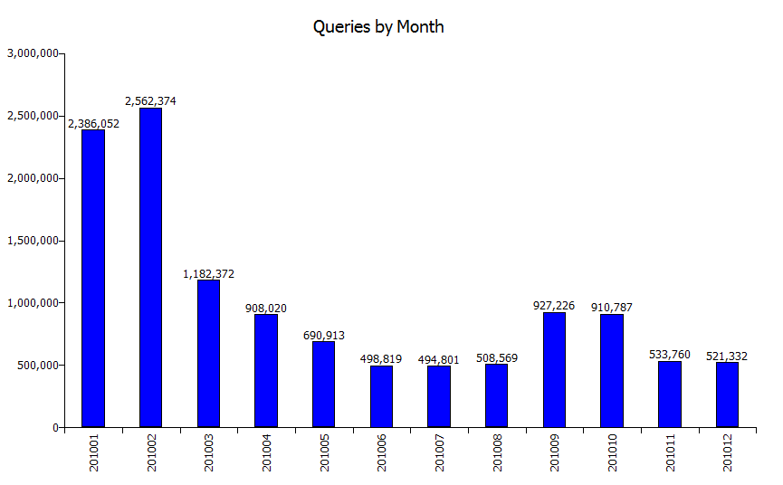

Slide 12
Environment Management
System Monitoring
System resource monitoring
CPU, Memory, Disk, Network
Usage tracking
Service status
Monitor services to ensure availability
Performance and Query Tuning

Slide 13
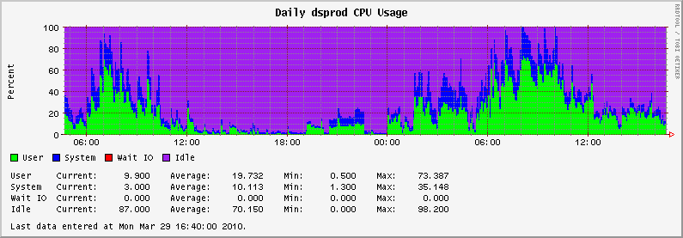
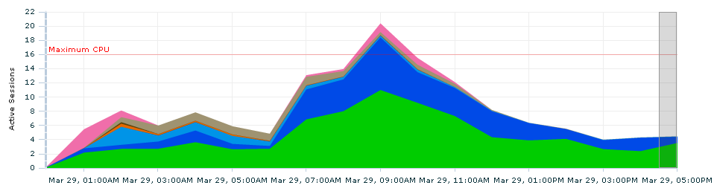
System Monitoring
Notes:
CPU Usage: Green–User Blue–System Red–I/O Waits Purple–Idle
Database Activity: Green–CPU Dark Blue–User I/O Light Blue-System I/O Brown-Network Pink-Other

Slide 14
Performance Tuning
Look for system bottlenecks
Look for database bottlenecks
Look for application bottlenecks
Look for query bottlenecks
80% of performance tuning is accomplished at the application level

Slide 15
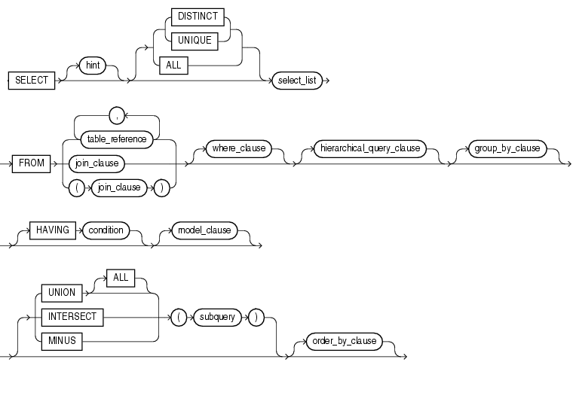
SQL Syntax Workflow
Notes:
SELECT syntax workflow

Slide 16
SELECT Syntax
SELECT <display fields>
FROM <sources>
WHERE <conditions>
GROUP BY <fields>
ORDER BY <fields>
HAVING <conditions>
<merge operators>

Slide 17
Sample Basic SQL
SELECT fname, lname, city, state
FROM employee
WHERE state IN (‘IL’,’IN’,’IA’,’MN’,’MI’,’OH’,’PA’)
ORDER BY state, city, lname, fname

Slide 18
Tuning SQL
Where’s the turbo switch?

Slide 19
Tuning SQL
Understand SQL Execution
Know the indexes
Understand JOIN’s
Using Hints

Slide 20
Understanding SQL Execution
EXPLAIN PLAN (Oracle)
Shows the execution plan
Does not execute the query
Not always available to users
Account executing EXPLAIN PLAN must have access to all underlying tables

Slide 21
Understanding SQL Execution
SHOWPLAN (SQL Server)
Shows the execution plan
Does not execute the query
set showplan_text on
<query>
set showplan_text off

Slide 22
EXPLAIN PLAN Output
SELECT STATEMENT ALL_ROWS
 | 5 HASH JOIN
 |  | 1 TABLE ACCESS FULL TABLE DM_STU.T_DM_RA_CONTACT
 |  | 4 HASH JOIN
 |  |  | 2 TABLE ACCESS FULL TABLE DM_STU.T_DM_RA_ANLS_FACT
 |  |  | 3 INDEX FAST FULL SCAN INDEX (UNIQUE) EDW.PK_STUDENT_TERM

Slide 23
TOAD’s English Version
1 Every row in the table DM_STU.T_DM_RA_CONTACT is read.
2 Every row in the table DM_STU.T_DM_RA_ANLS_FACT is read.
3 Rows were retrieved by performing a fast read of all index records in EDW.PK_STUDENT_TERM .
4 The result sets from steps 2, 3 were joined (hash).
5 The result sets from steps 1, 4 were joined (hash).
6 Rows were returned by the SELECT statement.
TOAD is a product from Quest Software.

Slide 24
Execution Plan
Full Table Scan
Every row in the table will be read
Is not always bad!!!
Index Range Scan
Uses the values of an index to shorten the number of rows reviewed
Index Fast Full Scan
Scans the full index, yet still faster than scanning a full table
Index Unique Scan
Scans the index, using the unique properties to identify a specific row

Slide 25
Use Indexes Effectively
Employee Table
Employee Index (unique=yes)
Last Name, First Name
Primary Key Index
Employee ID
Employee ID | Last Name | First Name | Home Dept | Phone | Employment Start Date
Primary Key | Index | Index

Slide 26
Sample Query 1
Employee ID | Last Name | First Name | Home Dept | Phone | Employment Start Date
Primary Key | Index | Index
SELECT Home_Dept, First_Name, Last_Name
FROM employee
WHERE Home_Dept = ‘Accounting’
FULL TABLE SCAN!!!

Slide 27
Sample Query 2
Employee ID | Last Name | First Name | Home Dept | Phone | Employment Start Date
Primary Key | Index | Index
SELECT Home_Dept, First_Name, Last_Name
FROM employee
WHERE Last_Name = ‘Smith’
INDEX RANGE SCAN

Slide 28
Sample Query 3
Employee ID | Last Name | First Name | Home Dept | Phone | Employment Start Date
Primary Key | Index | Index
SELECT Home_Dept, First_Name, Last_Name
FROM employee
WHERE Last_Name = ‘Rogers’ AND
First_Name = ‘Jane’
INDEX UNIQUE SCAN

Slide 29
Sample Query 4
Employee ID | Last Name | First Name | Home Dept | Phone | Employment Start Date
Primary Key | Index | Index
SELECT Home_Dept, First_Name, Last_Name
FROM employee
WHERE First_Name = ‘Jane’
INDEX RANGE SCAN

Slide 30
Why won’t it use my index?
Using NOT EQUAL (<>, !=)
Using IS NULL or IS NOT NULL
Using Functions
TO_CHAR(), TO_DATE()
SUBSTR(), LEFT(),TRIM()
Comparing Mismatched Data Types
Comparing a number to a VARCHAR2 (VARCHAR) column

Slide 31
Checking for indexes - Oracle
List indexes for table DEMO.EMPLOYEE
SELECT table_name, index_name,
column_name, column_position
FROM all_ind_columns
WHERE table_name = ‘EMPLOYEE’
AND table_owner = ‘DEMO’
ORDER BY index_name, column_position

Slide 32
Checking for indexes – SQL Server
List indexes for table DEMO.EMPLOYEE
sp_helpindex EMPLOYEE

Slide 33
Understanding Joins
INNER join
Includes records only that have match in second table
OUTER join
Includes all records of the primary table
Missing data from second table will be NULL

Slide 34
Inner Joins
STUDENTS
UIN | Student Name | Major
011011011 | Harold Jones | Math
123123123 | Beverly Hodges | English
551662773 | Sean Michaels | English
414141414 | Samantha Kay | French
CLASSES
UIN | Class
011011011 | MATH101
123123123 | MATH101
551662773 | MATH201
123123123 | FRENCH301
551662773 | BIOL223
551662773 | ACCTG140
SELECT UIN,Student_Name, Class
FROM students, classes
WHERE students.UIN=classes.UIN
ORDER BY UIN, Class

Slide 35
Inner Joins
SELECT UIN,Student_Name, Class
FROM students, classes
WHERE students.UIN=classes.UIN
ORDER BY UIN, Class
Results
UIN | Student_Name | Class
011011011 | Harold Jones | MATH101
123123123 | Beverly Hodges | MATH101
123123123 | Beverly Hodges | FRENCH301
551662773 | Sean Michaels | ACCTG140
551662773 | Sean Michaels | BIOL223
551662773 | Sean Michaels | MATH201

Slide 36
Outer Joins
SELECT UIN, Student_Name, Class
FROM students, classes
WHERE students.UIN=classes.UIN (+)
ORDER BY UIN, Class
Results
UIN | Student_Name | Class
011011011 | Harold Jones | MATH101
123123123 | Beverly Hodges | MATH101
123123123 | Beverly Hodges | FRENCH301
414141414 | Samantha Kay
551662773 | Sean Michaels | ACCTG140
551662773 | Sean Michaels | BIOL223
551662773 | Sean Michaels | MATH201

Slide 37
Outer Joins using SQL Server
SELECT UIN, Student_Name, Class
FROM students LEFT JOIN classes
ON students.UIN=classes.UIN
ORDER BY UIN, Class
Results
UIN | Student_Name | Class
011011011 | Harold Jones | MATH101
123123123 | Beverly Hodges | MATH101
123123123 | Beverly Hodges | FRENCH301
414141414 | Samantha Kay
551662773 | Sean Michaels | ACCTG140
551662773 | Sean Michaels | BIOL223
551662773 | Sean Michaels | MATH201

Slide 38
Avoid Unnecessary Operations
Only use these operations if necessary to retrieve the desired results
ORDER BY
Results may already be sorted or sorted results are not necessary for processing
DISTINCT
Always creates a sort

Slide 39
Using Hints
You may provide hints to the optimizer to affect the execution of your queries
Use hints sparingly. As your system changes, hints may do more harm than good.

Slide 40
Top Used Oracle Hints
INDEX
ORDERED
LEADING
PARALLEL
FIRST_ROWS
ALL_ROWS
USE_NL
USE_HASH
USE_MERGE

Slide 41
Oracle Hint Explanations
INDEX
Allows you to specify the index to use
ORDERED
Causes tables to be accessed in the order listed in the FROM clause
LEADING
Similar to ORDERED, but only identifies the first driving table

Slide 42
Oracle Hint Explanations
FIRST_ROWS
Optimizes the query to return the first rows as quickly as possible
ALL_ROWS
Optimizes the query to return all the rows as quickly as possible
PARALLEL
Divides the query into parts, executes them simultaneously, then merges the results

Slide 43
Oracle Hint Explanations
USE_NL
Executes the sub-queries as nested loops
USE_HASH
Similar to nested loop, but keeps the second table in memory
USE_MERGE
Executes the sub-queries, sorts the results and the merges the results together

Slide 44
Advanced SQL Tricks
Using the HAVING clause
Using in-line views
Use CASE statements
Using ROLLUP
Using LEAD and LAG
Using Dates
MERGE operations

Slide 45
The HAVING clause
SELECT student_name, COUNT(email_addr)
FROM student_email
GROUP BY student_name
HAVING COUNT(email_addr) > 1
ORDER BY COUNT(email_addr) DESC

Slide 46
In-Line Views
SELECT student_name, email_addr
FROM student_email
WHERE student_name in (
SELECT student_name
FROM student_email
GROUP BY student_name
HAVING COUNT(email_addr) > 1
)
ORDER BY student_name, email_addr

Slide 47
CASE Statement
SELECT CASE WHEN campus_cd = ‘1’ THEN ‘UIUC’
WHEN campus_cd = ‘2’ THEN ‘UIC’
WHEN campus_cd = ‘4’ THEN ‘UIS’
ELSE ‘INVALID’
END campus_cd_title,
college_title,
dept_title
FROM T_CAMPUS_COLLEGE_DEPT
ORDER by campus_cd, college_title, dept_title

Slide 48
LAG and LEAD (Oracle & MySQL)
LAG and LEAD provides access to a row at a given physical offset prior to or following that position.
SELECT last_name, hire_date, salary,
LAG(salary, 1, 0) OVER (ORDER BY hire_date) AS prev_sal
FROM employees
WHERE job_id = 'PU_CLERK';
Last_Name | Hire_Date | Salary | Prev_Sal
Khoo | 18-MAY-95 | 3100 | 0
Tobias | 24-JUL-97 | 2800 | 3100
Baida | 24-DEC-97 | 2900 | 2800
Himuro | 15-NOV-98 | 2600 | 2900
Colmenares | 10-AUG-99 | 2500 | 2600

Slide 49
GROUP BY ROLLUP (Oracle)
SELECT
CASE WHEN GROUPING(department_name)=1
THEN 'All Departments‘
ELSE department_name
END AS department,
CASE WHEN GROUPING(job_id)=1
THEN 'All Jobs‘
ELSE job_id
END AS job,
COUNT(*) AS "Total Empl",
AVG(salary) * 12 AS "Average Sal"
FROM employees e, departments d
WHERE d.department_id = e.department_id
GROUP BY ROLLUP (department_name, job_id)
ORDER BY department, job, "Total Empl", "Average Sal";

Slide 50
GROUP BY ROLLUP (SQL Server)
SELECT
CASE WHEN GROUPING(department_name)=1
THEN 'All Departments‘
ELSE department_name
END AS department,
CASE WHEN GROUPING(job_id)=1
THEN 'All Jobs‘
ELSE job_id
END AS job,
COUNT(*) AS "Total Empl",
AVG(salary) * 12 AS "Average Sal"
FROM employees e, departments d
WHERE d.department_id = e.department_id
GROUP BY department_name, job_id
WITH ROLLUP
ORDER BY department, job, "Total Empl", "Average Sal"

Slide 51
GROUP BY ROLLUP
DEPARTMENT | JOB | TOTAL EMP | AVERAGE SAL
Accounting | AC_ACCOUNT | 1 | 99600
Accounting | AC_MGR | 1 | 144000
Accounting | All Jobs | 2 | 121800
Administration | AD_ASST | 1 | 52800
Administration | All Jobs | 1 | 52800
All | Departments All Jobs | 106 | 77479.2453
Executive | AD_PRES | 1 | 288000
Executive | AD_VP | 2 | 204000
Executive | All Jobs | 3 | 232000
Finance | All Jobs | 6 | 103200
Finance | FI_ACCOUNT | 5 | 95040

Slide 52
DATES – ROUND() & TRUNC() -Oracle only
SELECT
TO_CHAR(SYSDATE,'DD-MON-YY HH:MI:SS AM') actual_date,
TO_CHAR(ROUND(SYSDATE), 'DD-MON-YY HH:MI:SS AM') round_date,
TO_CHAR(TRUNC(SYSDATE), 'DD-MON-YY HH:MI:SS AM') trunc_date
FROM DUAL;
ACTUAL_DATE | ROUND_DATE | TRUNC_DATE
3/28/2011 12:07:28 PM | 3/29/2011 12:00:00 AM | 3/28/2011 12:00:00 AM

Slide 53
MERGE Operations
UNION
returns only distinct rows that appear in either result
UNION ALL
returns all rows that appear in either result
INTERSECT
returns only those unique rows returned by both queries
MINUS / EXCEPT
returns only unique rows returned by the first query but not by the second
Notes:
MINUS is the Oracle and MySQL operator
EXCEPT is the SQL Server operator

Slide 54
INTERSECT example
SELECT product_id FROM inventories
INTERSECT
SELECT product_id FROM order_items
ORDER BY product_id;
Returns the Product Id for items in inventory for which there are orders.

Slide 55
Analytical Functions
Look up the analytical functions available from your database engine. The functions have become extremely powerful and can replace many complex, statistical calculations. However the functions are vendor add-ons and not consistent between database platforms.

Slide 56
Using Query Auditing
Auditing query activity
Execution times
Rows returned
Query text
Submitting application
Account

Slide 57
Prioritizing Your Attention
Average response time
Frequency of execution
Table size

Slide 58
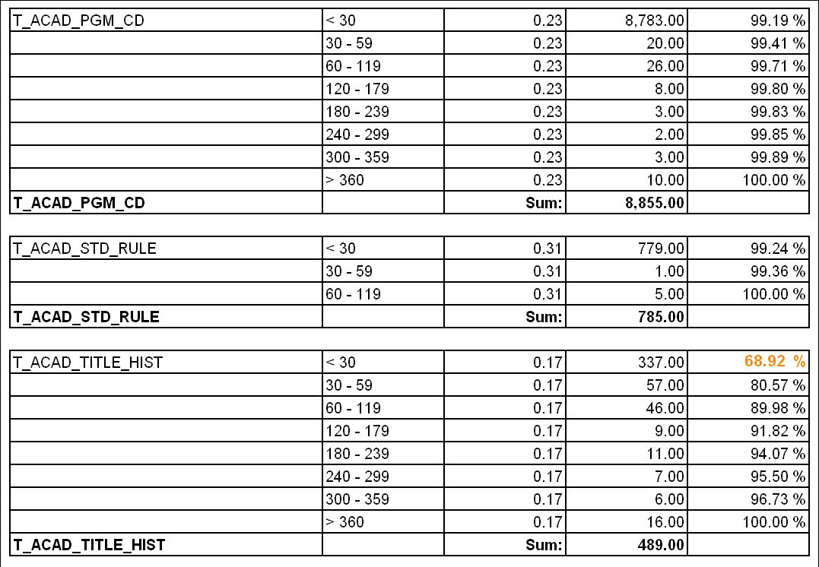
Table Name | Run Time | Table Size | Queries | Percentage

Slide 59
Analyzing Column Usage
Review WHERE column usage
Identify frequently used columns
Identify patterns of usage
Use patterns to identify potential indexes

Slide 60
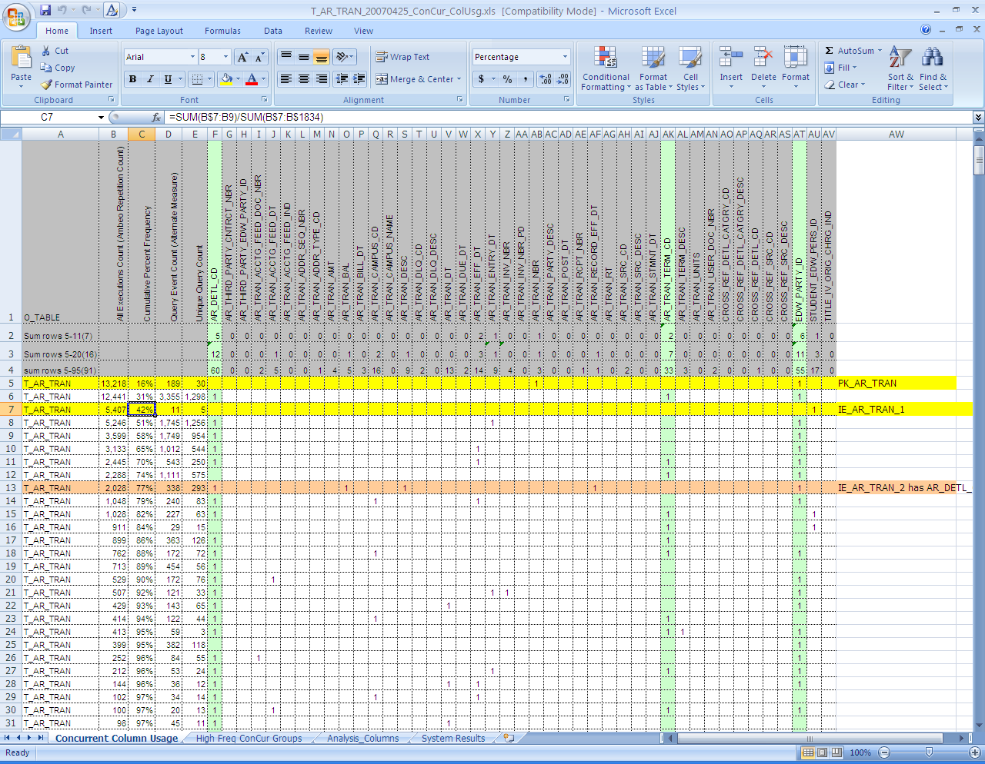

Slide 61
Too much of a good thing…
Indexes slow down inserts/updates
Each index adds additional I/O operations during each insert or update
Referential Integrity (foreign keys) slow down inserts/updates
RI is good for maintaining database integrity.

Slide 62
General tips to tuning
When performing benchmark timings, run the query twice. The first time causes the records to be loaded into cache.
Good indexes are very important.
Spend the most time on the WHERE clause.
Know your data.
Watch your TEMP space activity.
Queries with large tables respond best to parallel processing.

Slide 63
Using Tuning Tools
Quest SQL Optimizer for Oracle
Oracle Tuning Expert
Empower! For Oracle
Embarcadero DB Optimizer
Embarcadero Rapid SQL

Slide 64
Sample Query
SELECT a.netid_principal
FROM t_netid a
WHERE a.netid_principal IN
(SELECT b.netid_principal
FROM t_netid b GROUP BY b.netid_principal
HAVING COUNT(*) > 4)
ORDER BY a.netid_principal

Slide 65
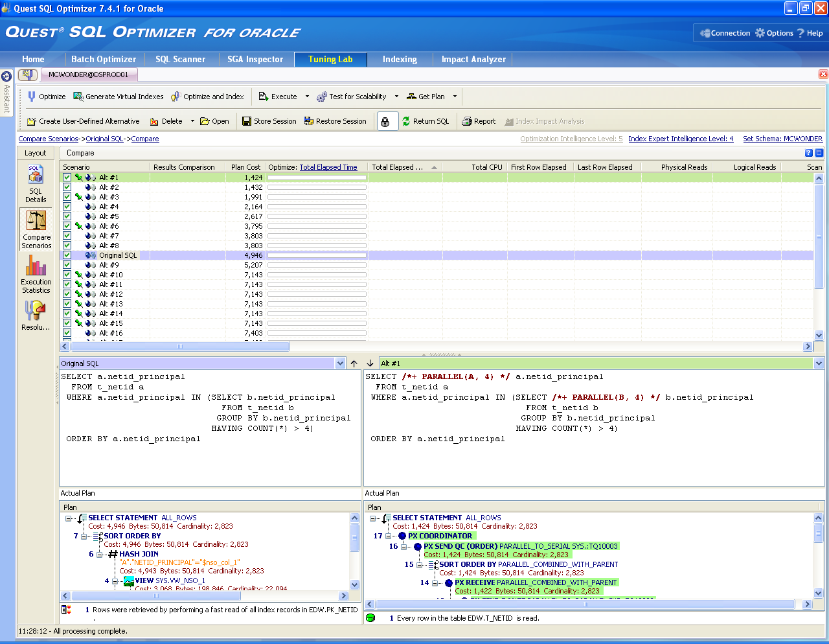

Slide 66
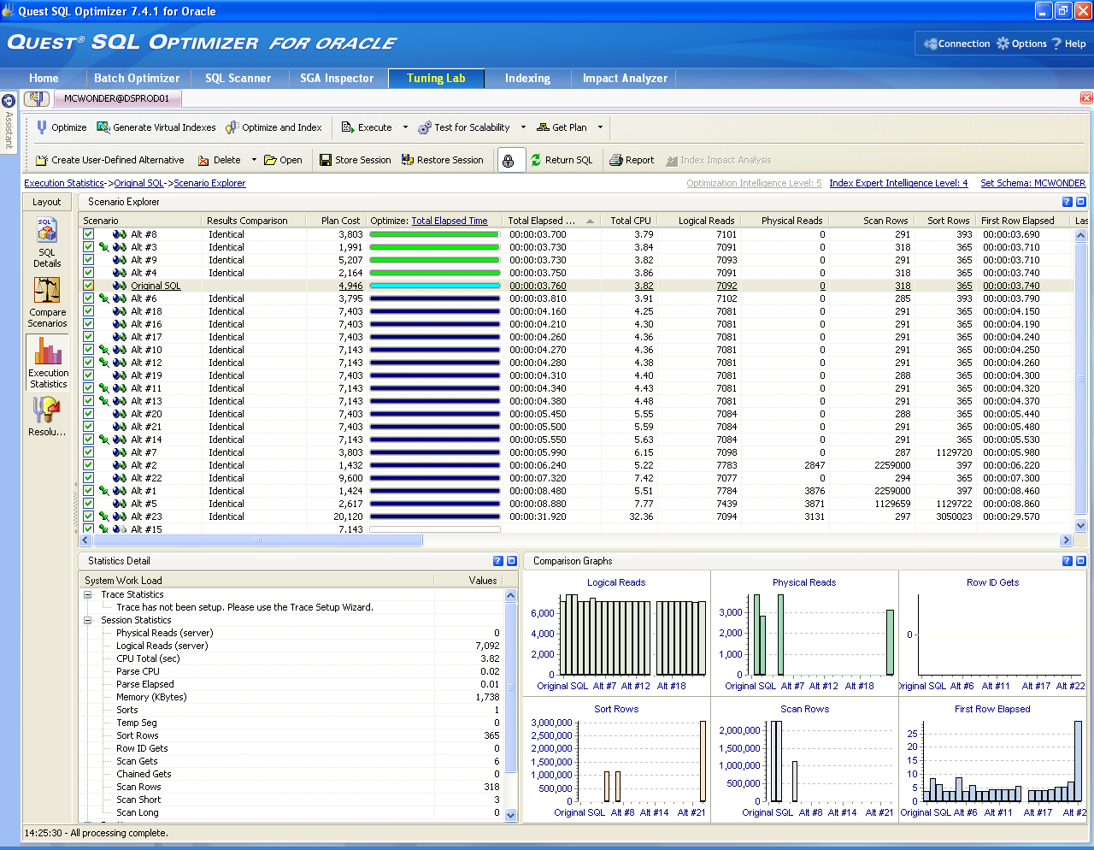

Slide 67
Best Query from Testing
SELECT /*+ PARALLEL_INDEX(TEMP0, 4) PARALLEL_INDEX(A, 4) */ A.netid_principal
FROM t_netid a,
(SELECT /*+ PARALLEL_INDEX(B, 4) */ B.netid_principal COL1
FROM t_netid b
GROUP BY B.netid_principal
HAVING COUNT(*) > 4) TEMP0
WHERE A.netid_principal = TEMP0.COL1
ORDER BY netid_principal

Slide 68
SQL Tips and Tricks
Oracle Technology Network
http://otn.oracle.com
Oracle Magazine
http://www.oramag.com
Ask Tom
http://asktom.oracle.com
Oracle 11g: The Complete Reference
Oracle Press
Mastering Oracle SQL
O’Reilly Press

Slide 69
SQL Tips and Tricks
Tips, Tricks, and Advice from the SQL Server Query Optimization Team
http://blogs.msdn.com/queryoptteam/default.aspx
Carstens Random Ramblings
http://www.bitbybit.dk/carsten/blog/
Excerpt from Gavin Powell book
http://www.oracle.com/technology/books/pdfs/powell_ch.pdf
The Data Warehouse Institute
http://www.twdi.org

Slide 70
Oracle Campus Agreement
Oracle database (10g, 11g)
Oracle application server
Oracle client
Advanced Security

Slide 71
Free Oracle Products
SQL Developer
Database 10g Express Edition
Berkeley DB
Application Express
JDeveloper
Can be downloaded from Oracle Technology Network

Slide 72
SQL Developer
Oracle SQL Developer is a free graphical tool for database development. With SQL Developer, you can browse database objects, run SQL statements and SQL scripts, and edit and debug PL/SQL statements. You can also run any number of provided reports, as well as create and save your own.
Users can create Database Connections for non-Oracle databases MySQL, SQL Server, MS Access and Sybase for object and data browsing. Limited worksheet capabilities also available for these databases.

Slide 73
Oracle Database 10g Express Edition (XE)
entry-level
small-footprint database
based on the Oracle Database 10g Release 2 code
free to develop, deploy, and distribute
simple to administer

Slide 74
Oracle Application Express
Oracle Application Express (Oracle APEX), formerly called HTML DB, is a rapid web application development tool for the Oracle database.
Develop fully in a web browser
Easily develop and deploy applications

Slide 75
Discussion and Questions
Contact: Michael Wonderlich, mcwonder@uillinois.edu

